Slide 1
RNDPS v2: Customizing the Mojaloop Switch for Instant Payments
Leveraging Speed, Reliability, and Interoperability in Financial Services

Slide 2

Introduction
Purpose of the Presentation: To showcase the enhancements in the Mojaloop Switch customized to support instant retail payments and financial inclusion in Rwanda.

Slide 3
Key Objectives for the RNDPS v2 Switch
Operational Availability: High availability for uninterrupted and constant transaction processing
Transaction Speed: Guarantee of transaction completion within 10 seconds
Beneficiary Confirmation: Ensure that the recipient DFSP confirms the receipt of funds
Payment Certainty: High reliability and certainty of payment execution.
Interoperability: Seamless integration with various payment systems and financial institutions
Product Diversification: Supports multiple financial products including transfers, merchant payments, bill payments, bulk payments, cash-in/out, …
Value Added Services: Services like credit transfers, payment initiation, and request-to-pay

Slide 4
Key Enablers for RNDPS v2 success
To achieve its objectives, the RNDPS v2 Switch required the following enablers:
User-Friendly Interfaces:
Intuitive interfaces that make it easy and transparent to use for all users (Hub and Participants)
Automated Reconciliation:
Real-time reconciliation to maintain accurate account positions, and increase trust in the ecosystem.
Fraud Mitigation:
Tools to prevent fraud, such as risk-based transaction limits, and message signing for authentication and integrity
Exception Handling (Dispute Management):
Mechanisms to claim funds in cases of fraud or technical errors and request returns in record times
System Performance and Scalability:
High processing performance under high-load conditions
Business Continuity and Resilience:
Robust systems that ensure 24/7 availability, continuous support, and contigencies.
Feedback Loop and Continuous Improvement:
Feedback collection, analysis and prioritization, iterative design
Agile Development, Feature Updates and Enhancements, Performance Optimization

Slide 5
RNDPS v2: Customizing the Mojaloop Switch for Instant Payments
Helm charts

Slide 6
RNDPS v2 Helm Charts
The RNDPS V2 Helm Charts are designed to deploy and manage the RNDPS V2 ecosystem, building upon the foundation of the Mojaloop Helm Charts. These charts incorporate custom values and configurations tailored specifically for RNDPS V2, along with a suite of extended services to meet the unique requirements of the Rwandan context.

Slide 7
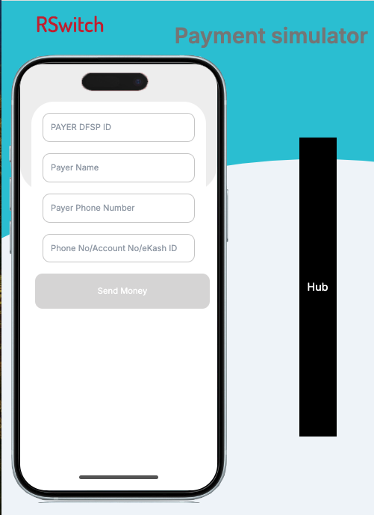
Integrating Custom Services into Helm Charts deployment
1
Extended Functionality
2
Seamless Integration
RNDPS V2 incorporates custom services beyond standard Mojaloop offerings. These additions cater to Rwanda's unique financial requirements.
Custom services are fully integrated with core Mojaloop components. This ensures smooth upgrades.
3
New services
ISO20022 Connector, Simulators that supports ISO20022,Participant portals

Slide 8
Enhanced Security with Private Docker Images
1
Image Replacement
Public docker.io images are replaced with private, secure alternatives. This shift enhances overall system security.
2
Private docker registry & helm registry
Private images are hosted on Gitlab. This provides better control over image distribution and versioning.
3
Access Control
Strict access controls are implemented for image repositories. Only authorized personnel can access and modify images.

Slide 9
Production-Grade Backend Helm Charts
While the example-mojaloop-backend Helm chart is a convenient, all-in-one solution for PoC and testing, we developed production-ready Helm charts with key improvements:
Persistent Storage: Persistent volumes for data retention and reliability, supporting continuous operations.
High Availability MySQL InnoDB Cluster: Ensures data consistency, failover capabilities, and improved performance for production environments.
Advanced MySQL Configurations: Optimized for our specific workloads, enhancing both performance and stability.
Enhanced Kafka Configurations: Customizable topic partitions and replication to meet scalability and reliability needs.
Pod Affinity Rules: Configured to optimize workload placement

Slide 10
Advanced Database Management and Scalability Enhancements
MySQL Operator
InnoDB Cluster
Automated MySQL cluster management is implemented. This ensures optimal database performance and reliability.
High-availability MySQL solution is utilized. It provides automatic failover and load balancing for database operations.
Mysql Read Replicas
Horizontal Pod Autoscaler (HPA)
The use of read replicas to offload read-heavy traffic from the primary database
Automatic scaling of pods based on resource utilization. This ensures optimal performance during varying load conditions.

Slide 11



Streamlined Deployment
Production configurations
Optimized Resource Allocation
Faster Deployment
DFSP simulators are disabled. This simplifies the deployment process and reduces resource usage.
Resources are allocated more efficiently. This leads to improved performance.
Streamlined charts result in quicker deployment times. This enables more agile development and testing cycles.

Slide 12
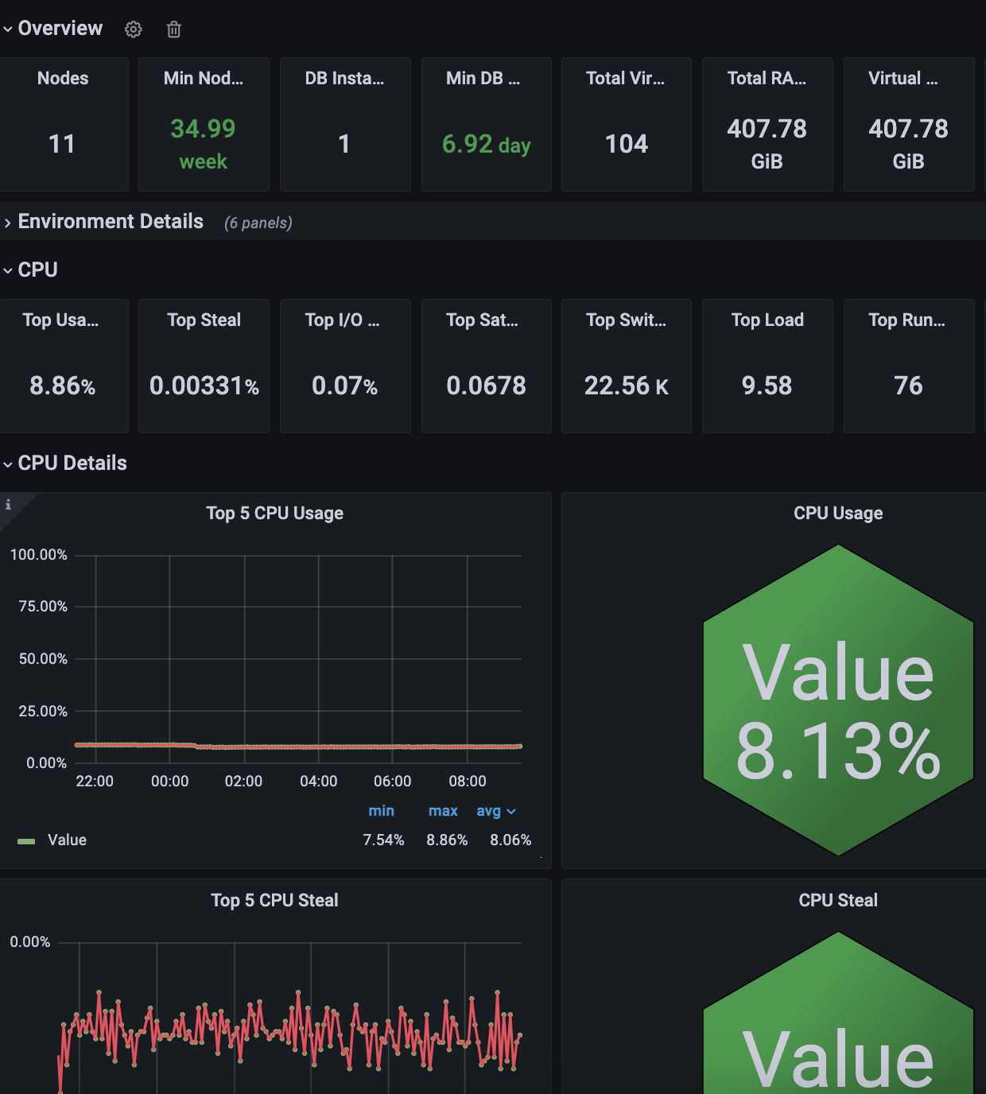


Enhanced Monitoring and Observability
Grafana Dashboards
Updated and customized dashboards for detailed visibility into RNDPS V2 metrics and health
Log Monitoring
Centralized log collection and analysis is implemented. This facilitates quick troubleshooting and system health monitoring.
Log parsers to extract meaningful insight from log data were added

Slide 13
Data Integrity and Backup Strategies
Automated Backup Scheduling:
Ensures data availability by consistently backing up databases, minimizing data loss risk.
Backup File Retention Policies:
Helps manage storage by removing unnecessary old backups while ensuring critical data is still accessible.

Slide 14


End.
Thank You.

